Slide 1
Jenkins

Slide 2
What is Jenkins?
Jenkins is an open source automation tool written in Java programming language that allows continuous integration.
Jenkins builds and tests our software projects, which continuously making it easier for developers to integrate changes to the project, and making it easier for users to obtain a fresh build.
Jenkins builds and tests our software projects which continuously making it easier for developers to integrate changes to the project, and making it easier for users to obtain a fresh build.
It also allows us to continuously deliver our software by integrating with a large number of testing and deployment technologies.
Jenkins offers a straightforward way to set up a continuous integration or continuous delivery environment for almost any combination of languages and source code repositories using pipelines, as well as automating other routine development tasks.
With the help of Jenkins, organizations can speed up the software development process through automation. Jenkins adds development life-cycle processes of all kinds, including build, document, test, package, stage, deploy static analysis and much more.

Slide 3
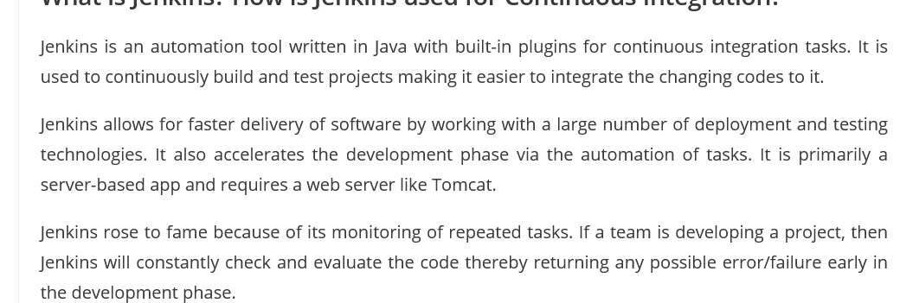

Slide 4
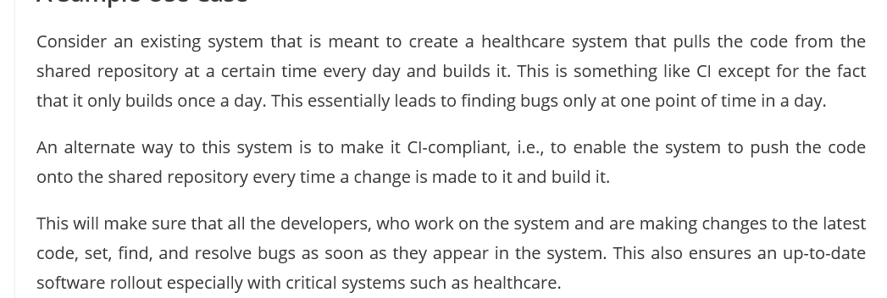
Healthcare : System Requirement

Slide 5
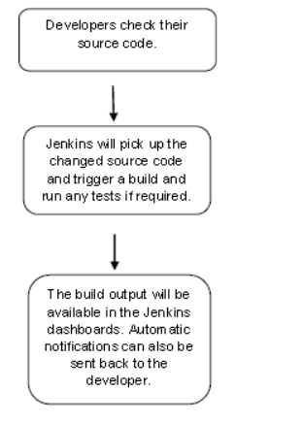
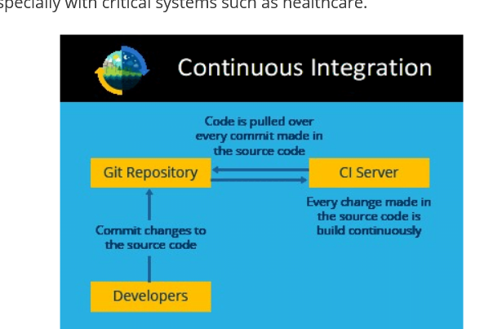
Jenkins :Work Flow

Slide 6

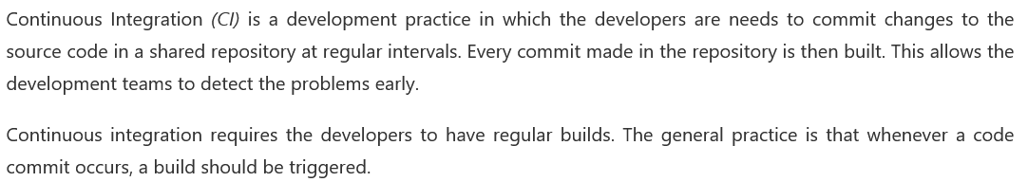

Slide 7
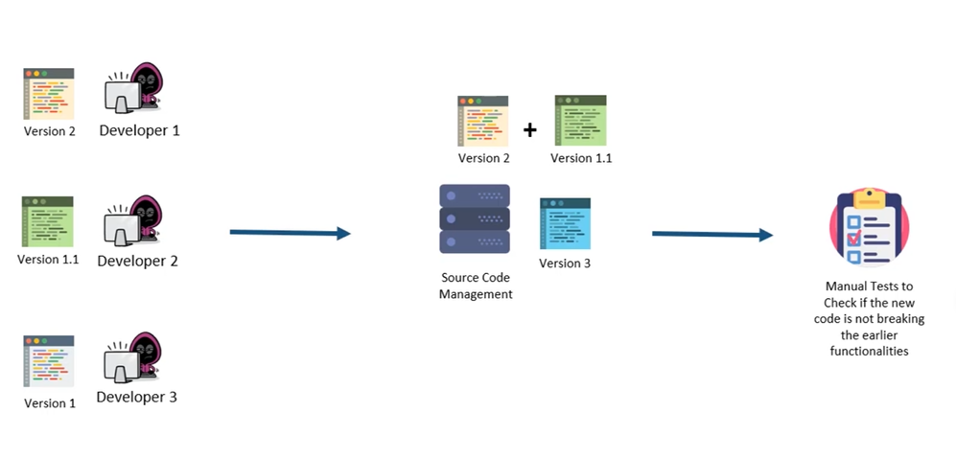
Issues : Before Continuous Integration

Slide 8
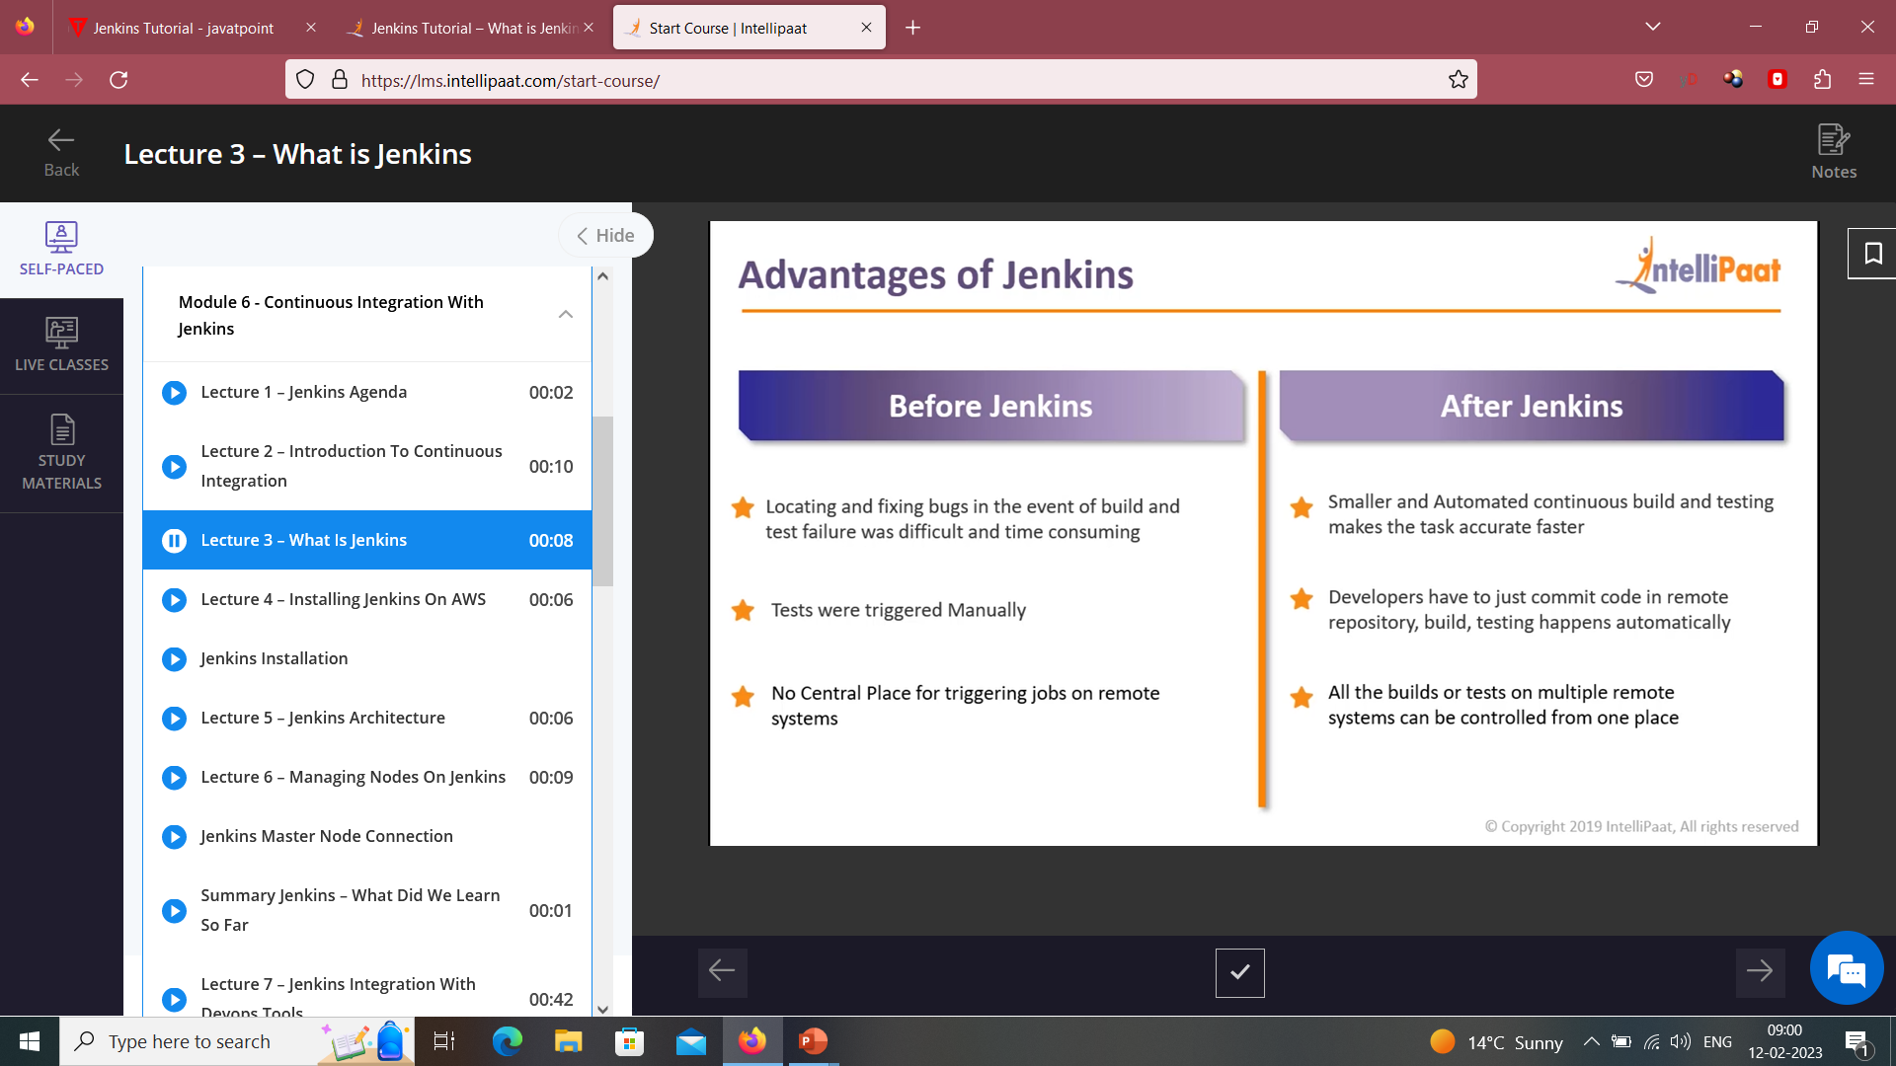

Slide 9
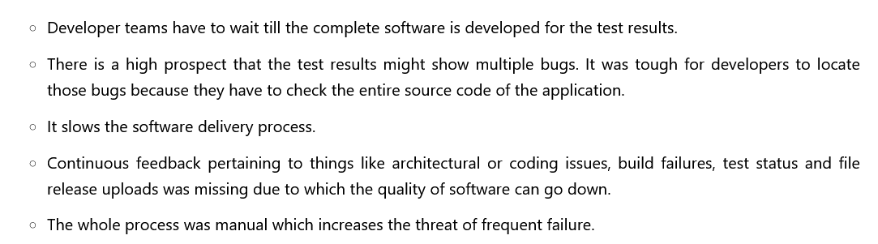

Slide 10

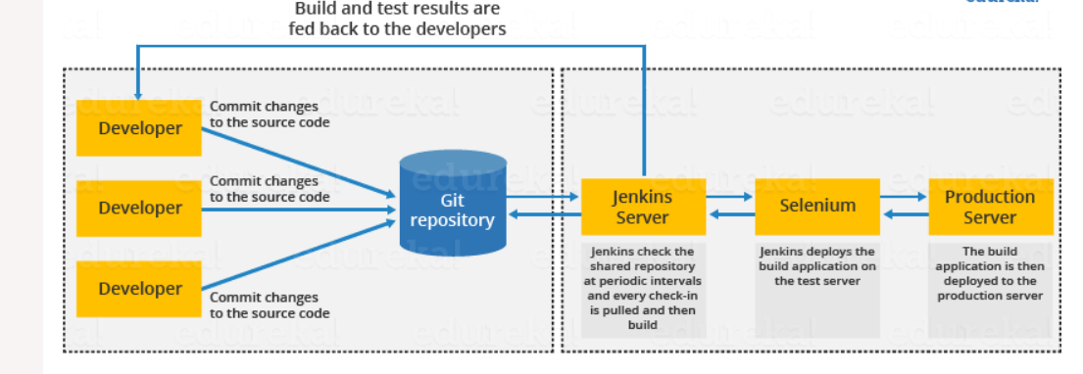

Slide 11
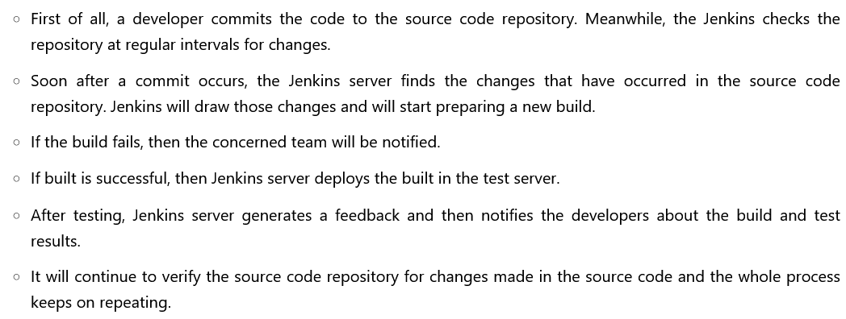

Slide 12
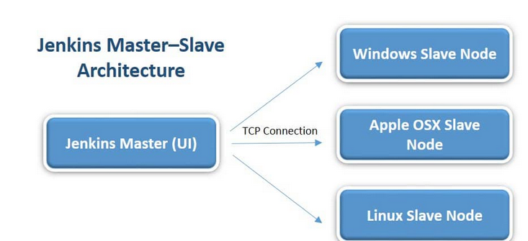
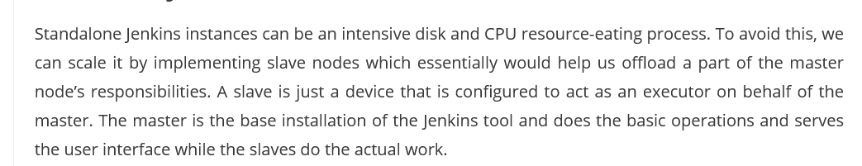
Jenkins : Master Slave Architecture

Slide 13
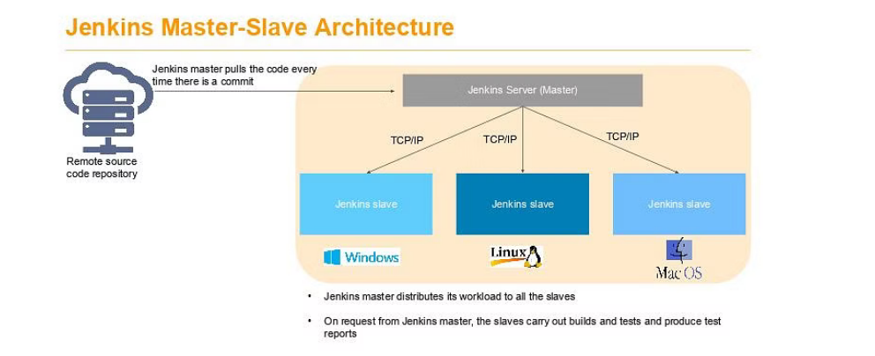

Slide 14
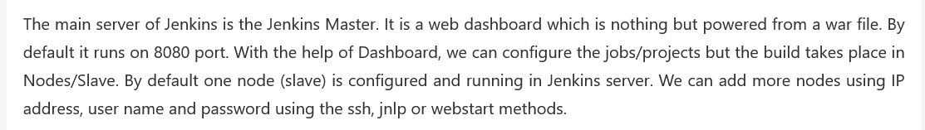
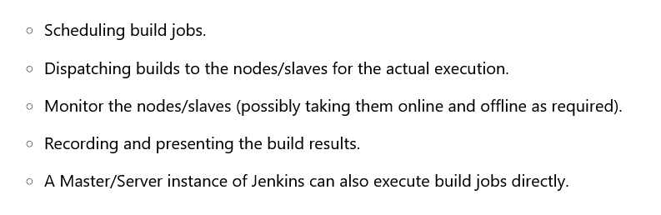

Slide 15
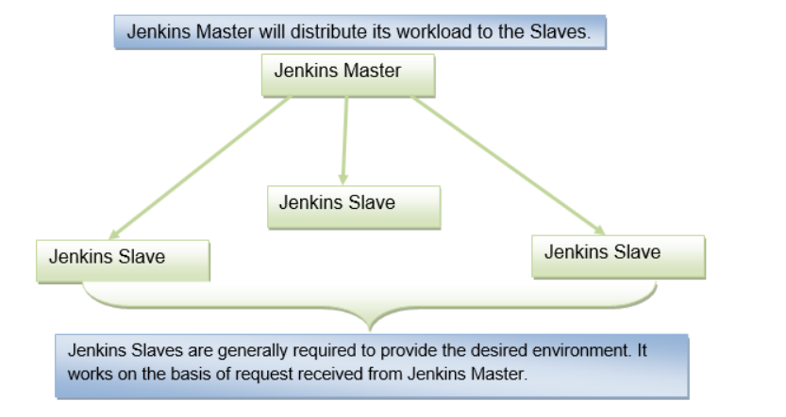
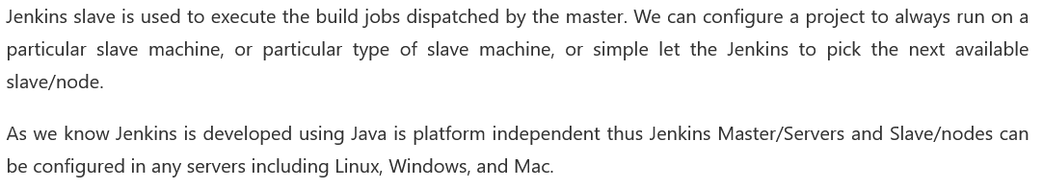

Slide 16
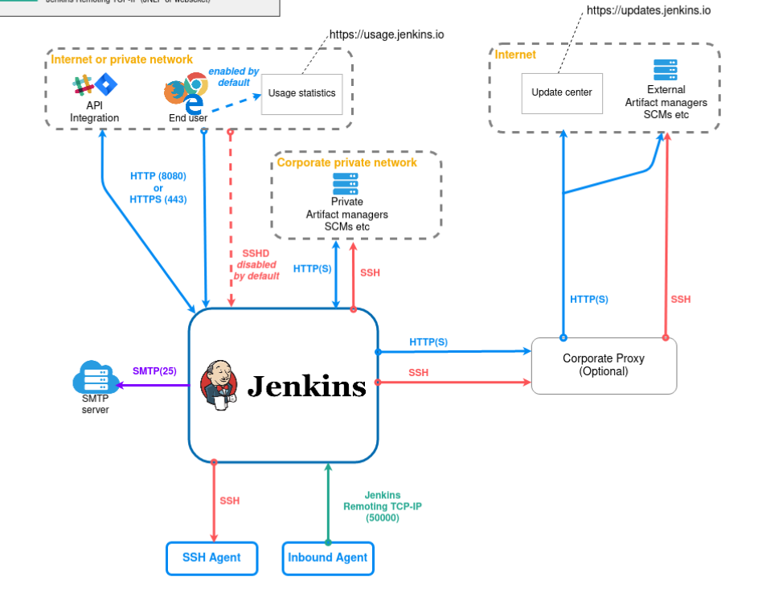
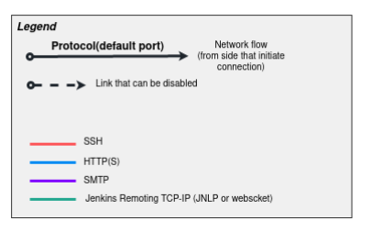

Slide 17
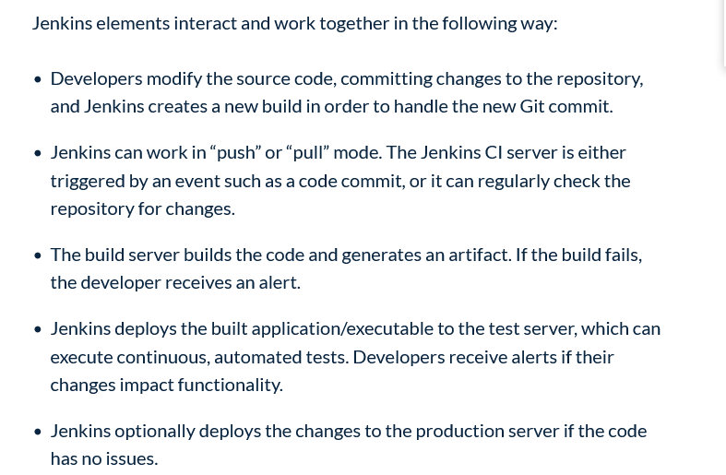

Slide 18
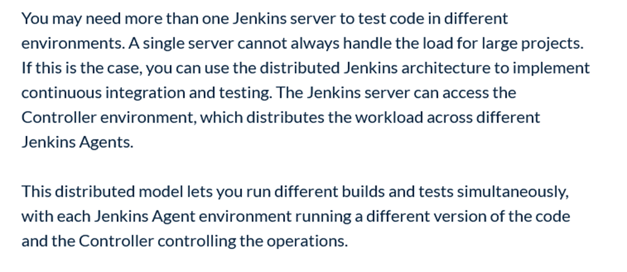

Slide 19
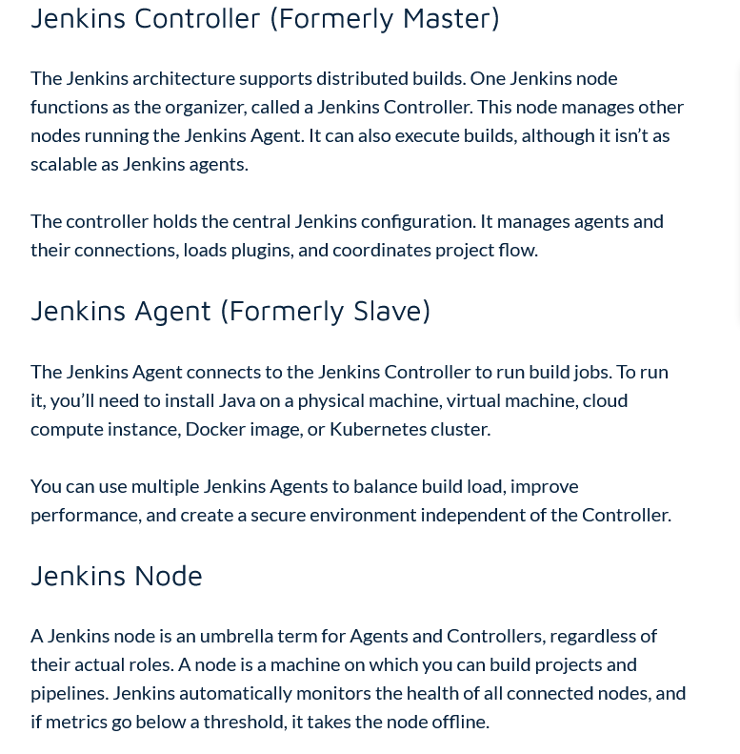

Slide 20
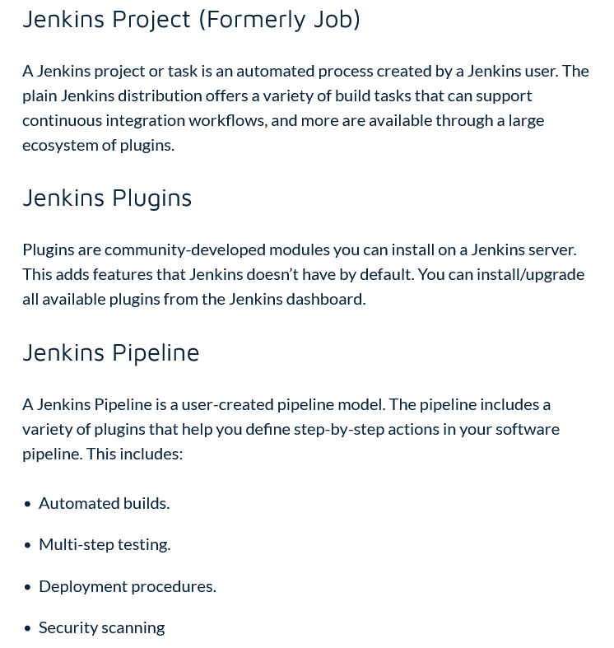

Slide 21
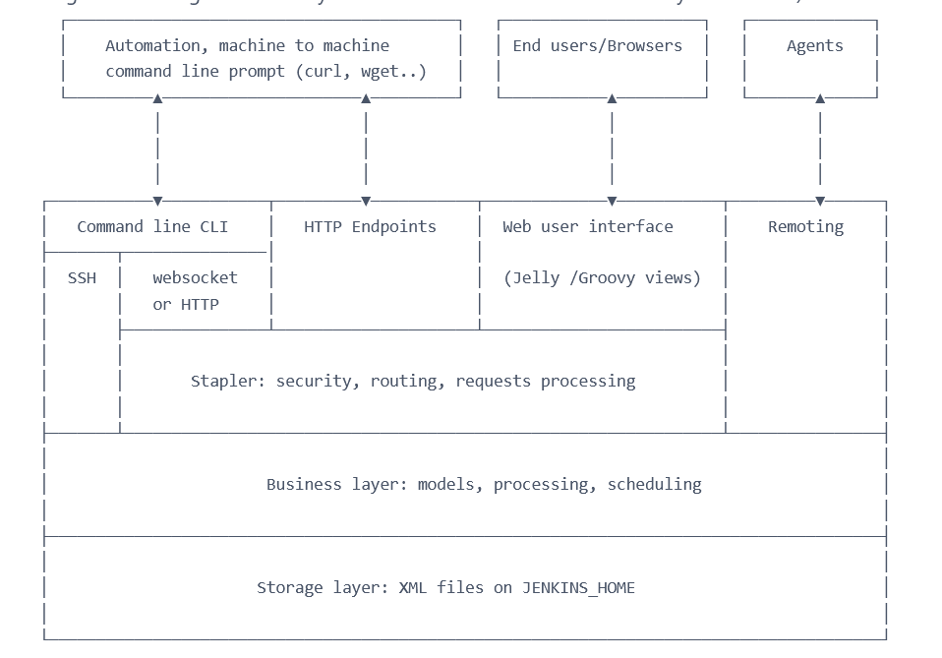
High Level : View

Slide 22
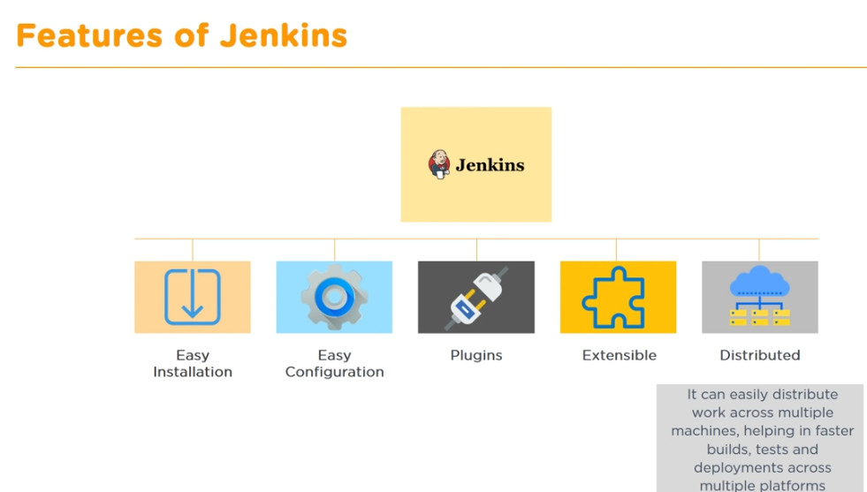

Slide 23
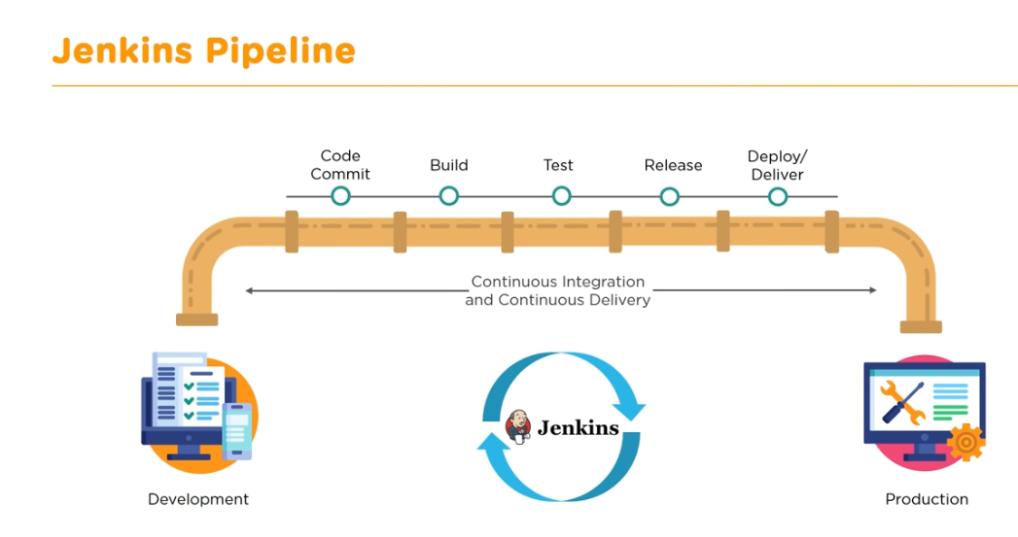

Slide 24
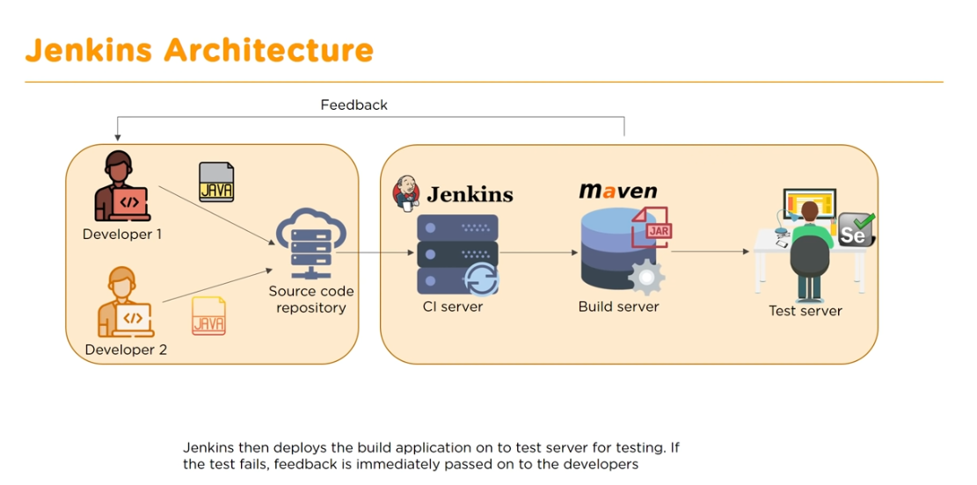

Slide 25
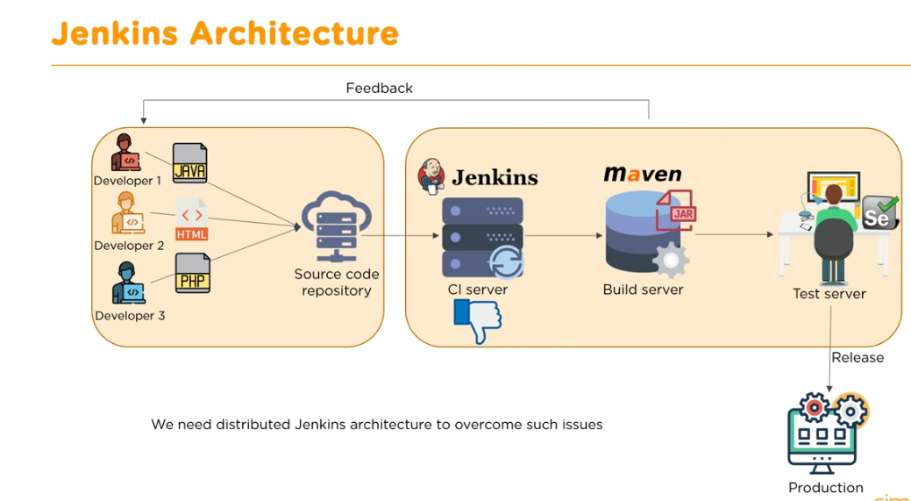

Slide 26
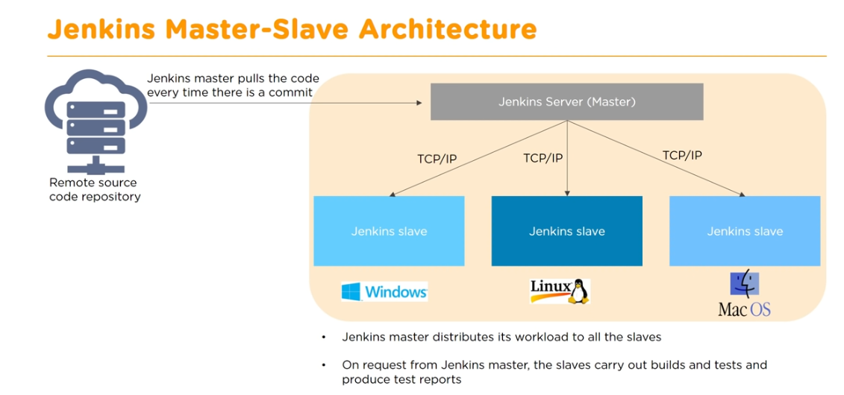

Slide 27
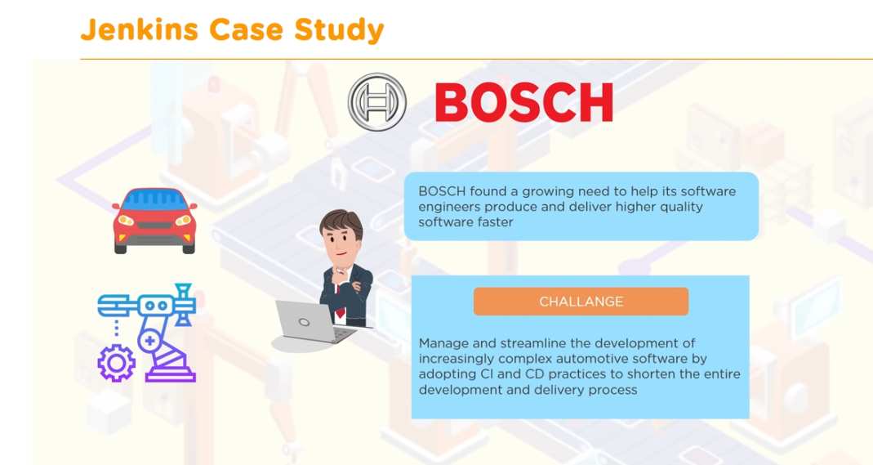

Slide 28
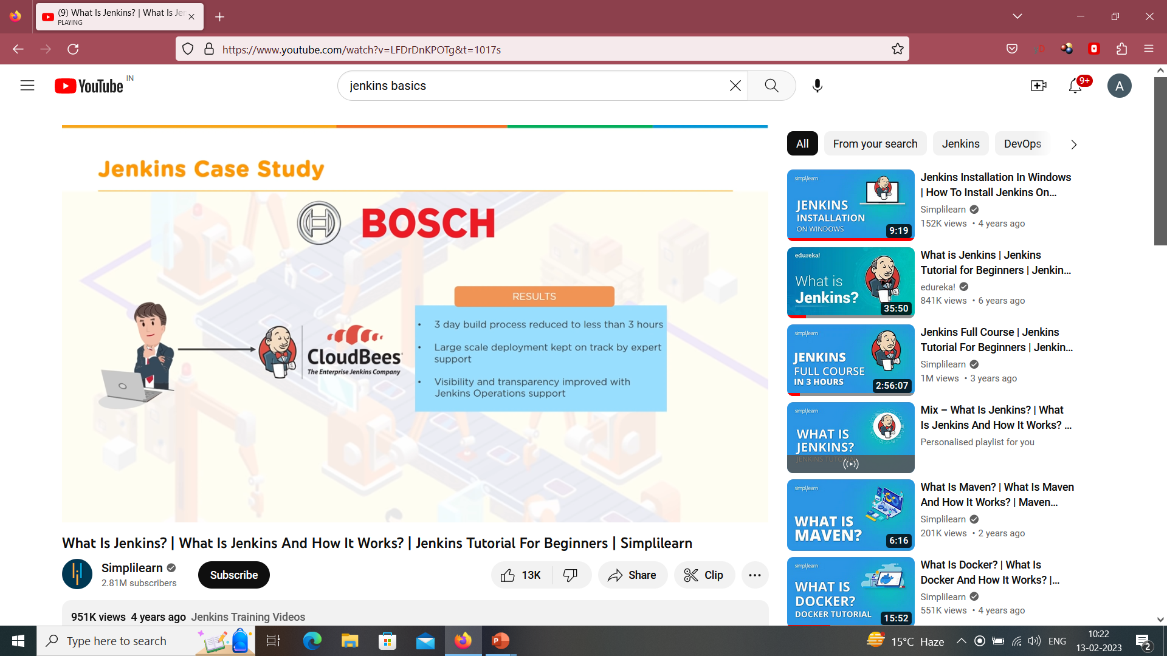

Slide 29
Distributed Architecture

Slide 30
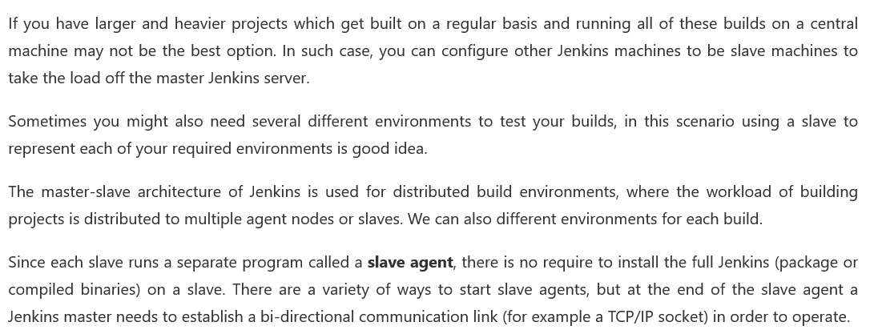
Jenkins :Perspective of Master Slave Architecture

Slide 31
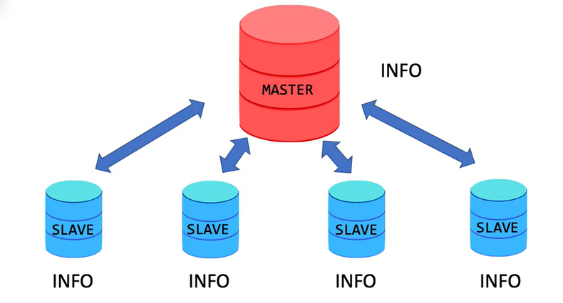
Basics : Master Slave Architecture

Slide 32

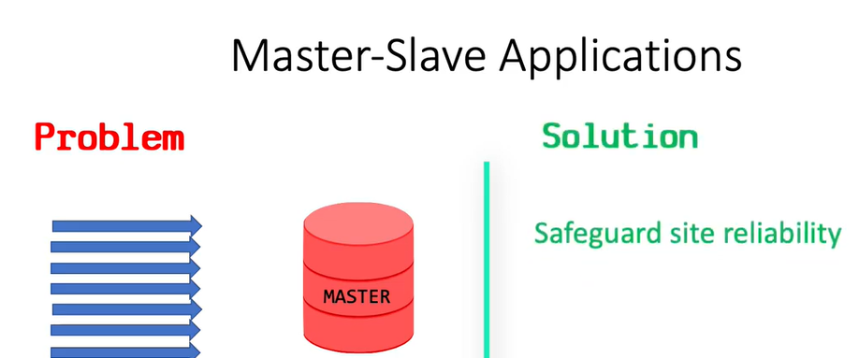

Slide 33
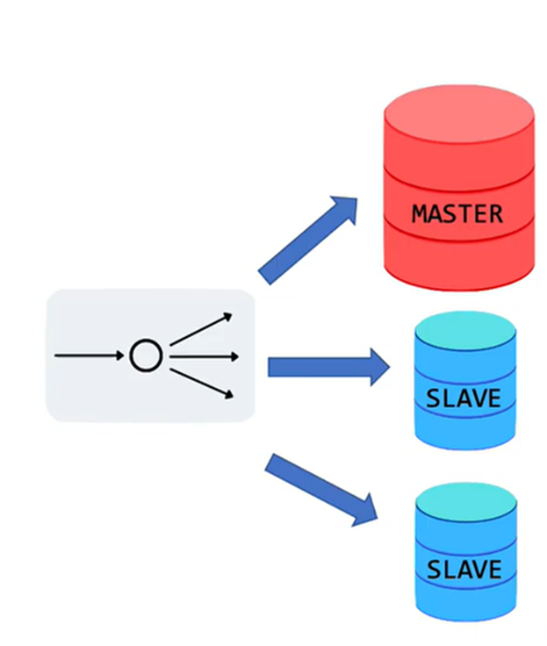
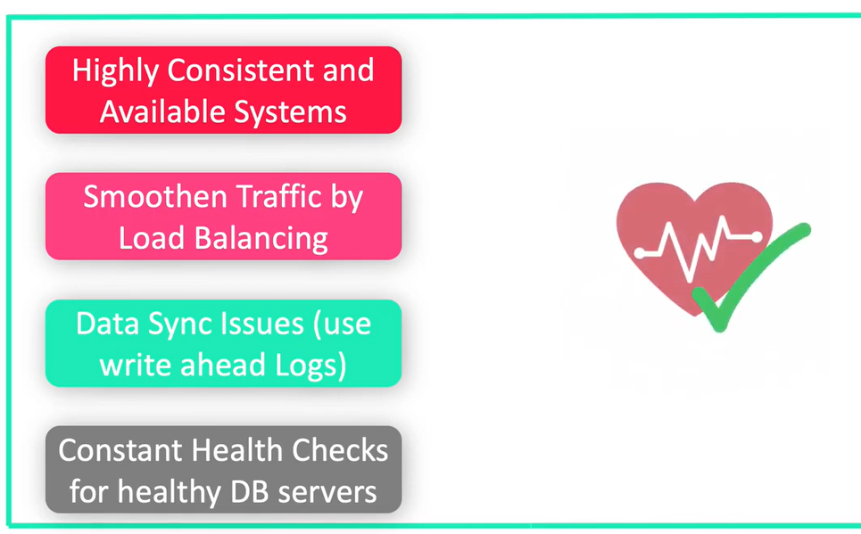

Slide 34

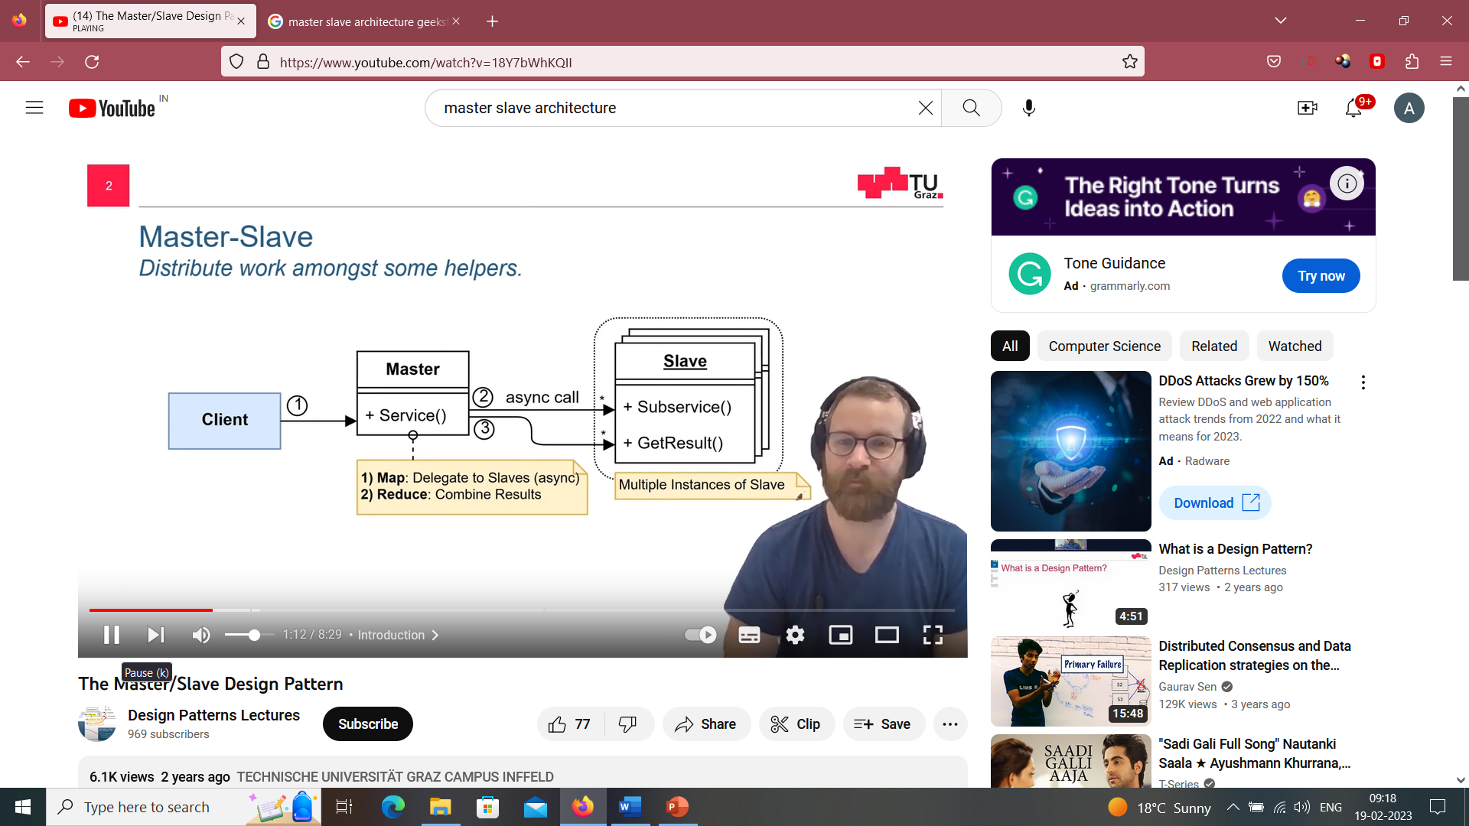

Slide 35

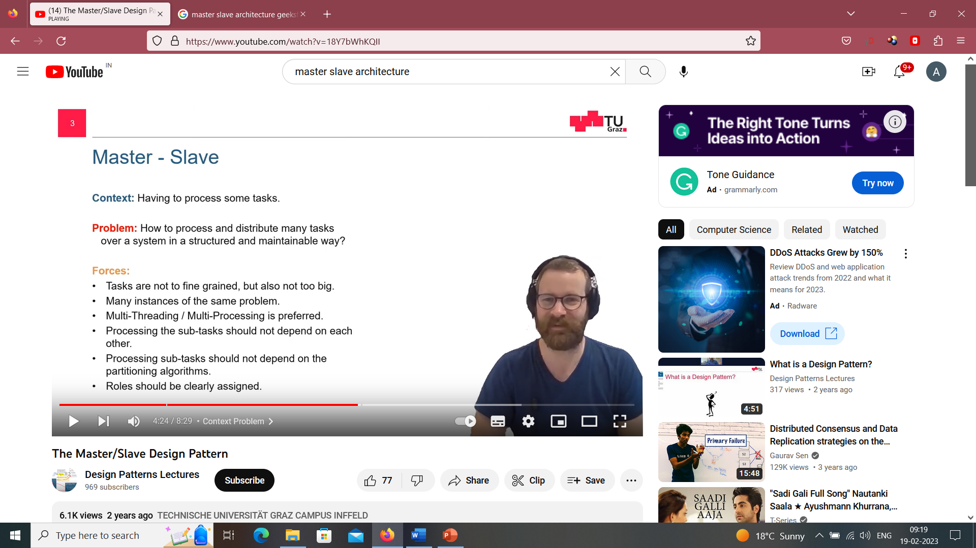
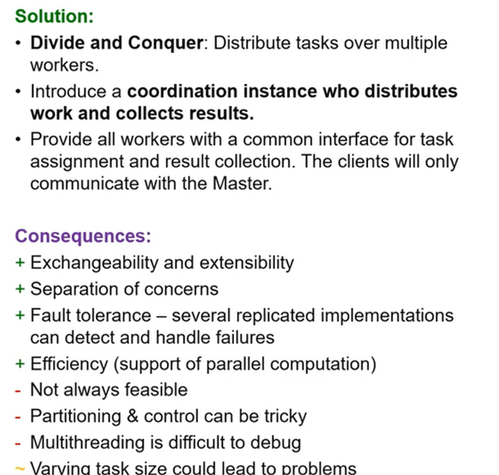

Slide 36
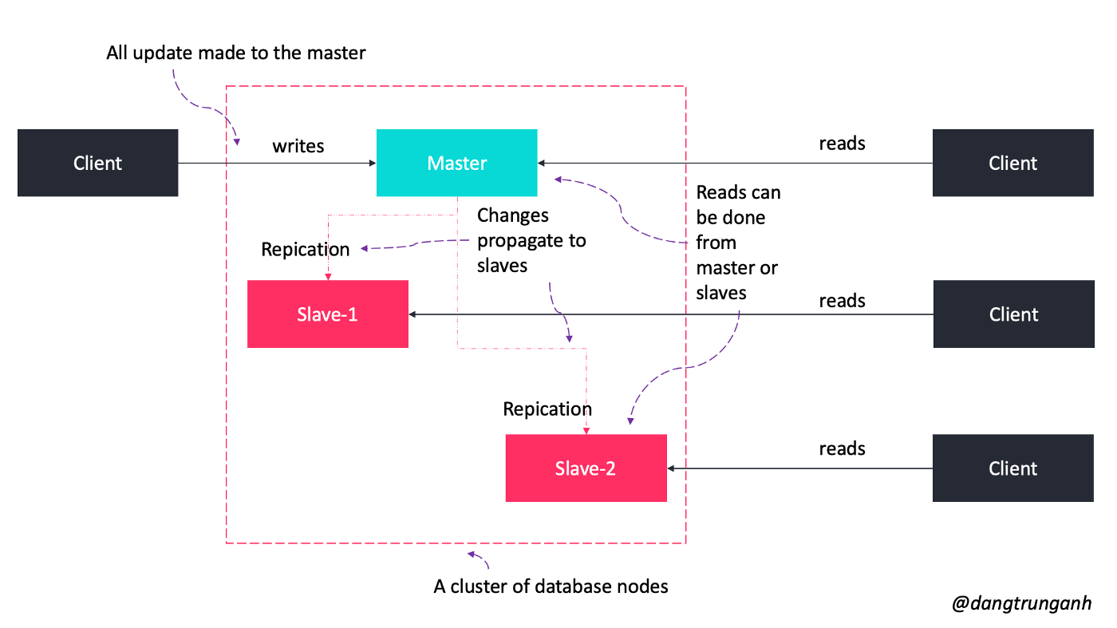

Slide 37
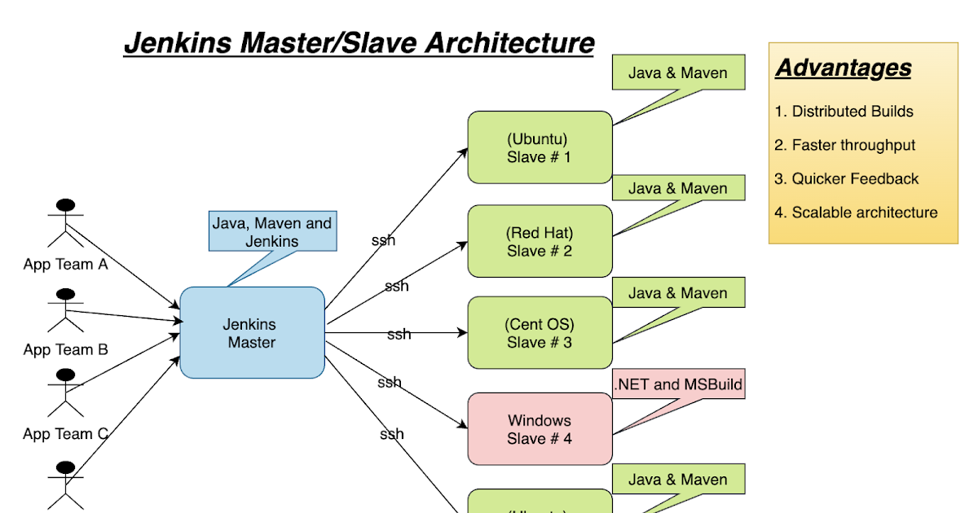

Slide 38
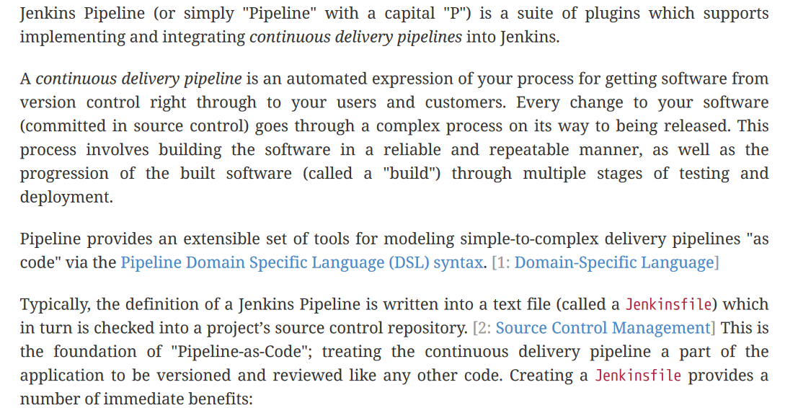
What is Jenkins Pipeline?

Slide 39
What is Jenkins Pipeline?

Slide 40
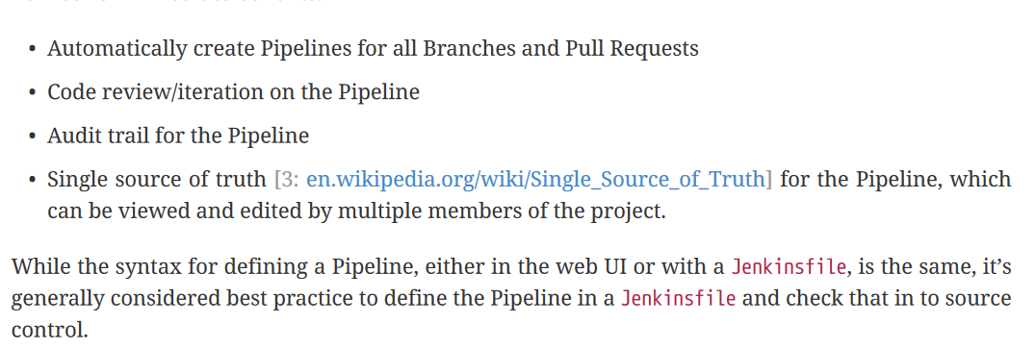

Slide 41
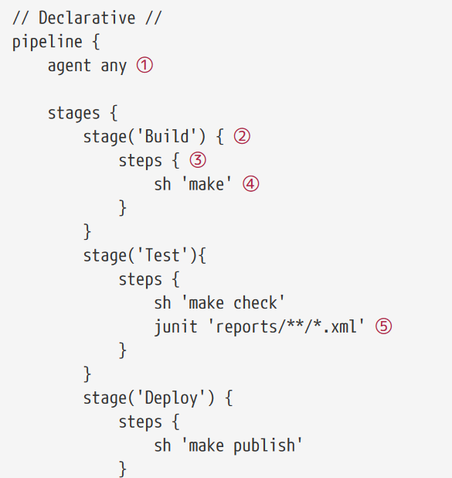
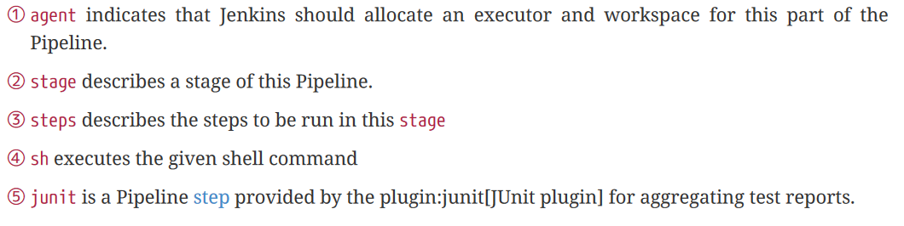
Jenkins File

Slide 42
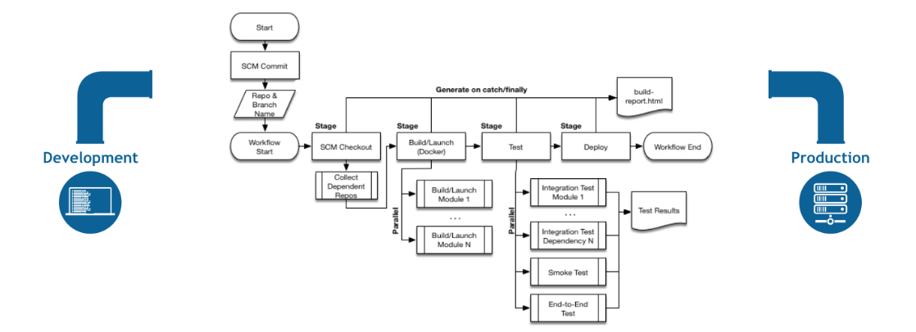
Pipeline Flow

Slide 43
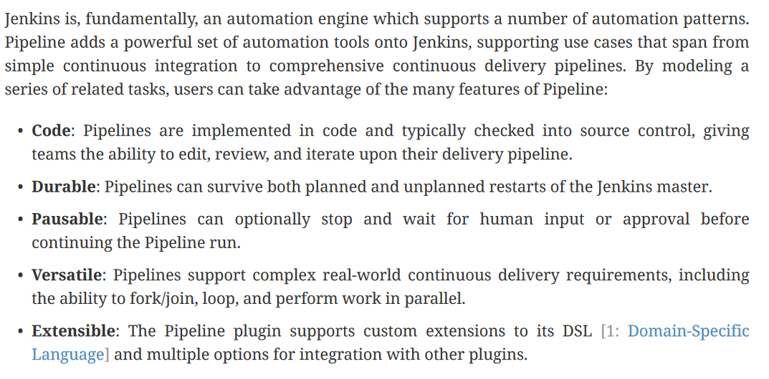
Why Jenkins Pipeline?

Slide 44
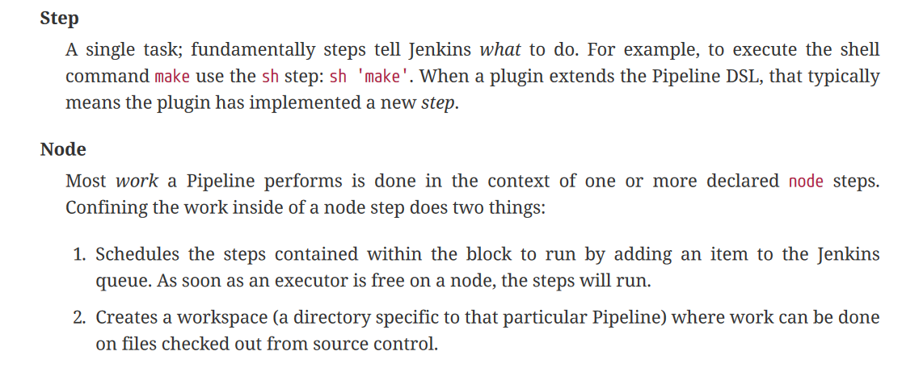
Pipeline Terms

Slide 45

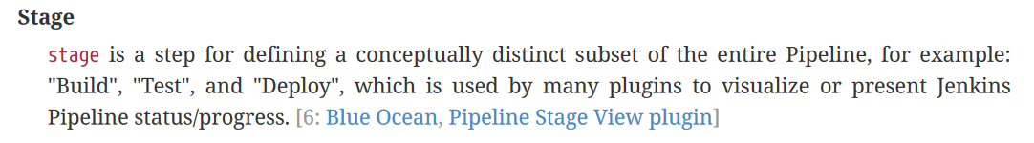
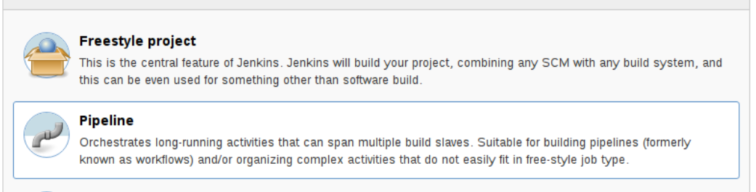

Slide 46


Pipeline Vs Freestyle

Slide 47


